Slide 1
Student Attendance System
Developed by
Zakaria Ahmmed
Under Supervision
Abdul Bari

Slide 2
Project Overview
Admit Student By Class
Give Attendance For Each Class
View Attendance Status For Each Student For Any Month
Filtering & Shorting
Tools and Technology
Hibernate
Bootstrap & CSS
Restful Web Service
Angular JS
Routing
Filter
Link: https://github.com/ahmmedzakaria/Student-AttendanceManagement.git

Slide 3
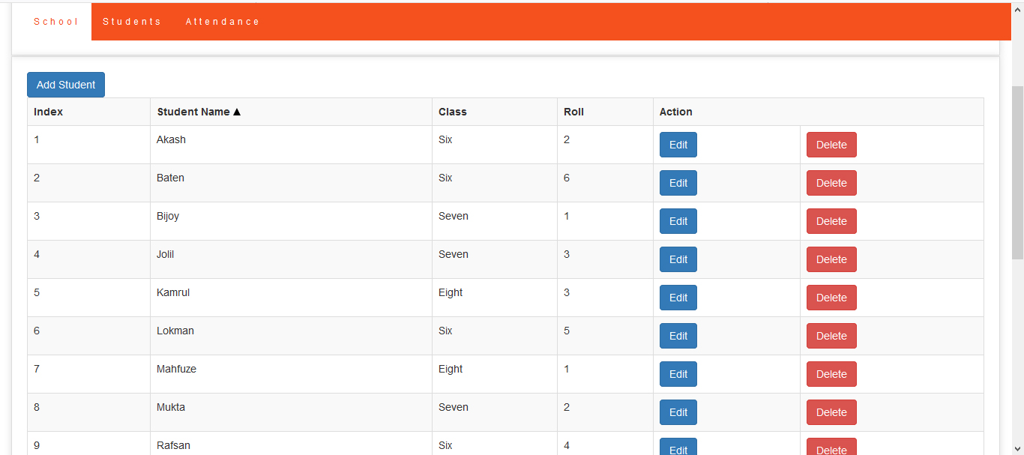
Student Admission Page

Slide 4
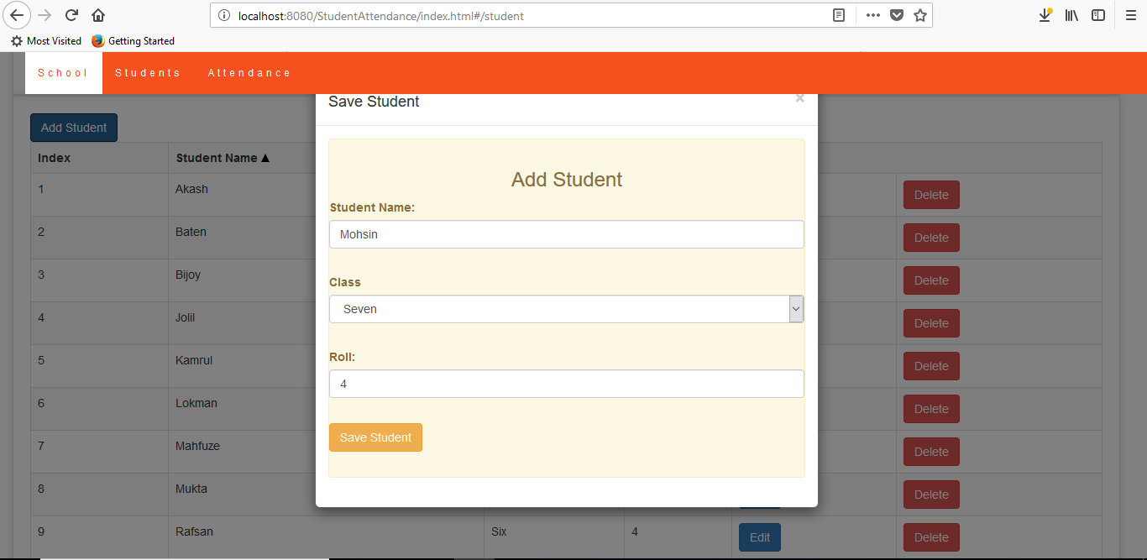
Admit Student

Slide 5
Admit Student

Slide 6
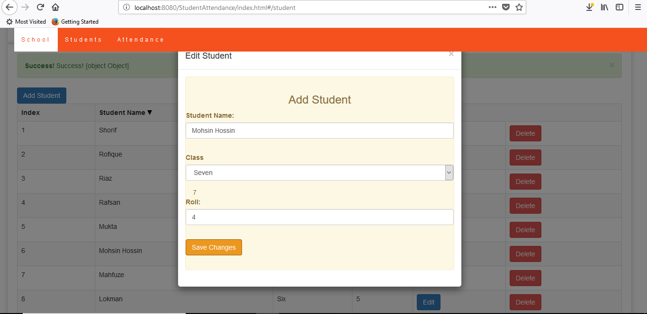
Edit Student

Slide 7
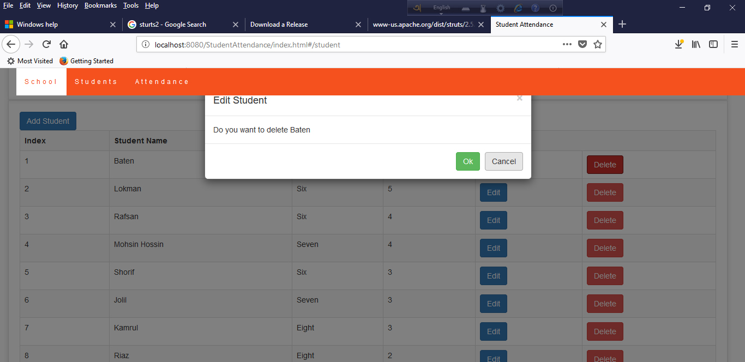
Delete Student

Slide 8
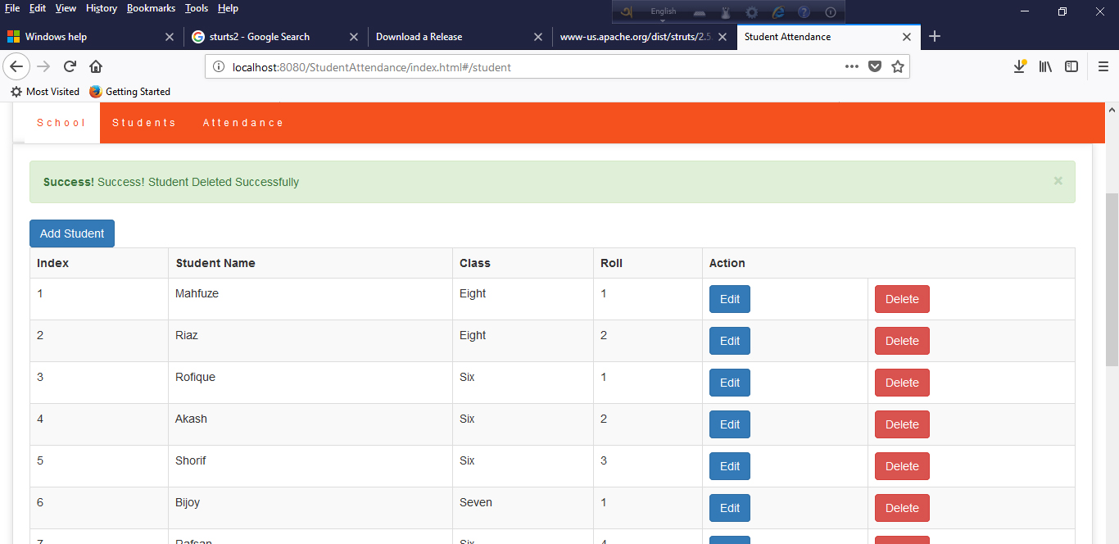
Delete Status

Slide 9
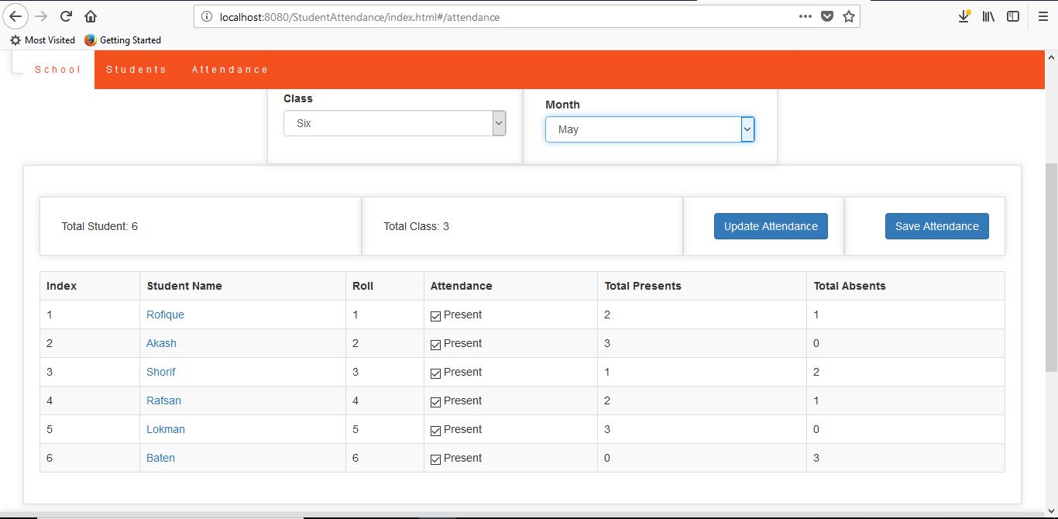
Student Attendance

Slide 10
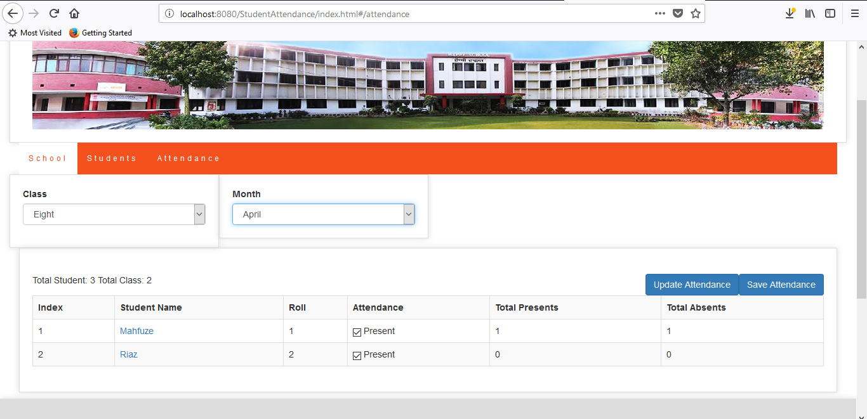
Attendance Status By Month

Slide 11
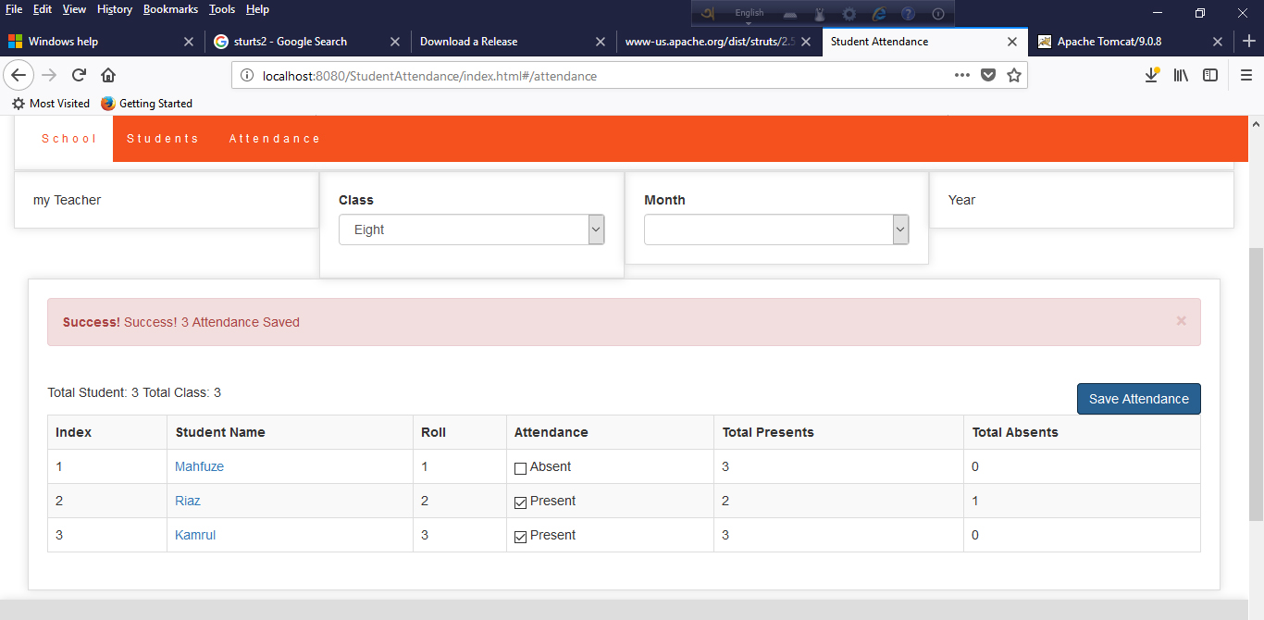
Save Attendance

Slide 12
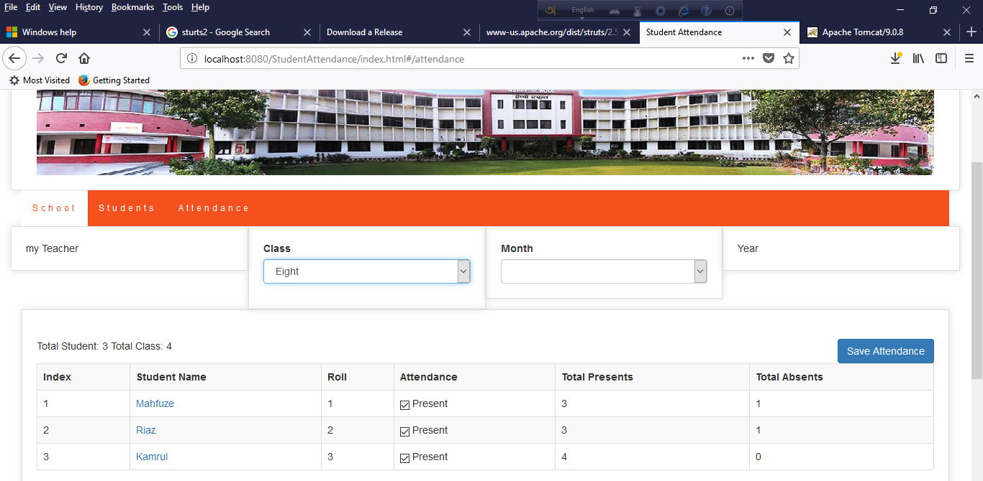
Saved Attendance Status

Slide 13
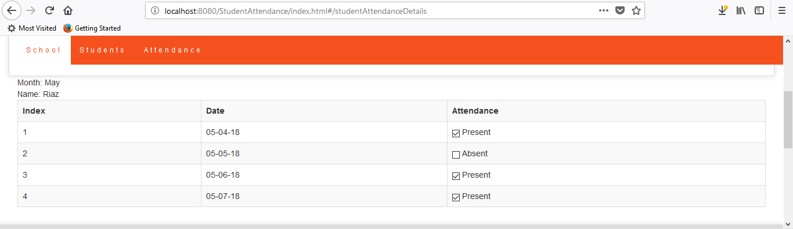
Individual Attendance Status

